Slide 1
A Brief Introduction to E-commerce Knowledge Graph
Xiujie Song
Sep 21st, 2022

Slide 2
Outline
Introduction
Knowledge Graph in E-commerce
Knowledge Graph Construction
Knowledge Graph Application
Conclusion

Slide 3

Introduction
What is Knowledge Graph?
A semantic network describing relationships among entities in real world.
Concepts:
Entity: basic element of KG
Concepts: a general notion for a collection of entities
Mention: linguistic phrases expressing entities in text
e.g. Yao Ming is a basketball player in NBA.
Usually constructed by triples.
<entity1, relationship, entity2> or <entity, attribute, value>
e.g. <Yao Ming, plays-in, NBA>, <Yao Ming, height, 2.29m>
Example: ConceptNet
ConceptNet is a freely-available semantic network, designed to help computers understand the meanings of words that people use.
ConcepNet: https://conceptnet.io/

Slide 4
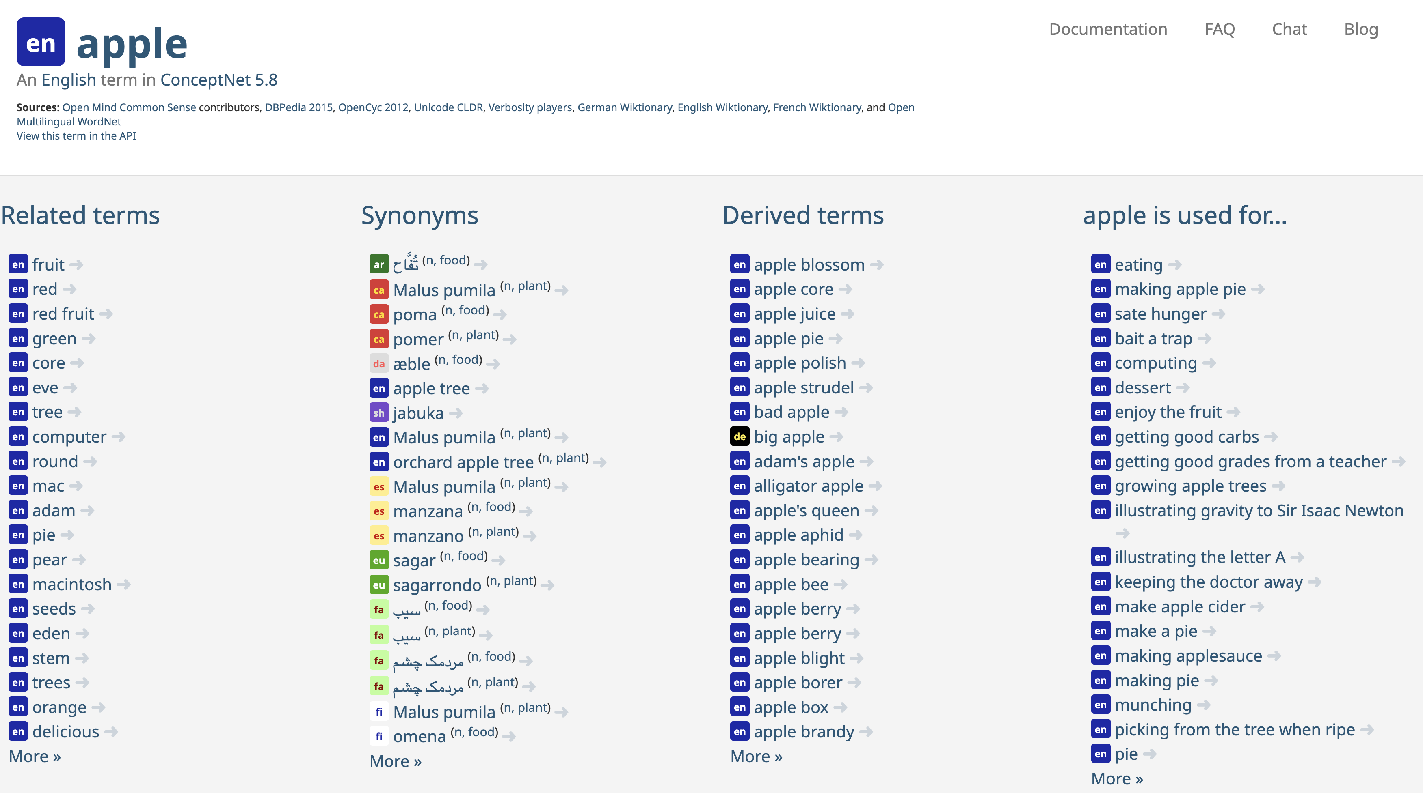
Introduction

Slide 5
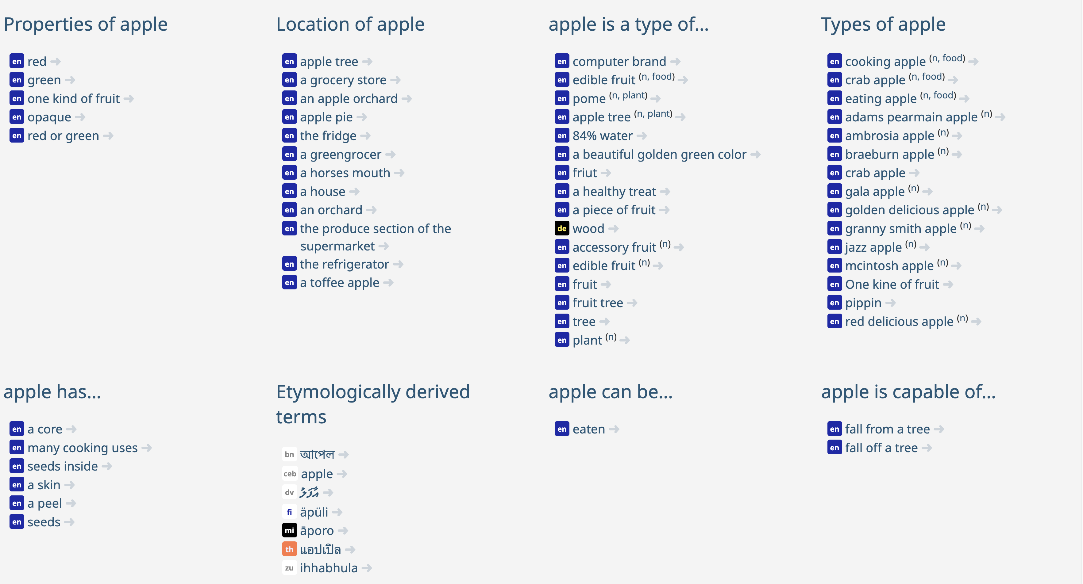
Introduction

Slide 6


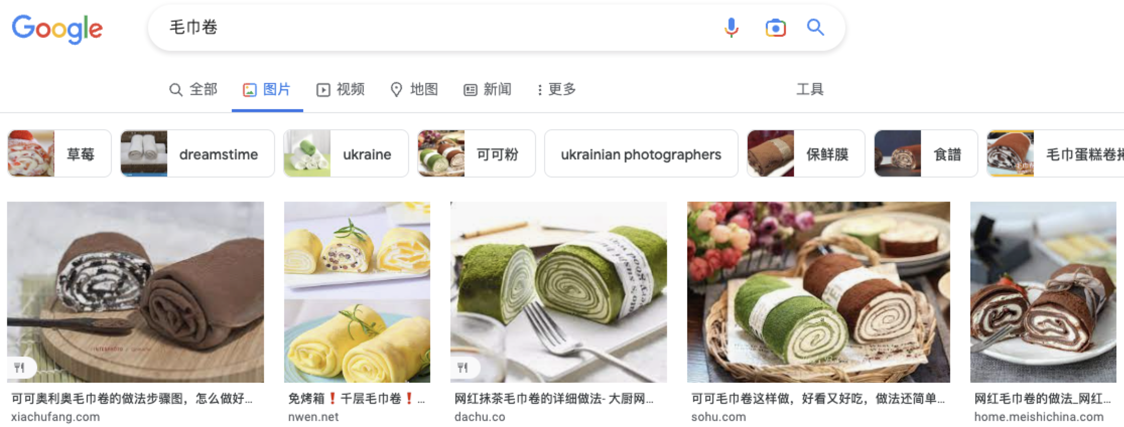
Introduction
Why Knowledge Graph?
External knowledge is necessary for models.
In my opinion, it is a collection of knowledge aims to make models more intelligent or assist model for a specific task.
like wikipedia to human.
e.g.
“毛巾卷”
(towel roll)
Applications
Question Answering
Recommendation
Search
…
❌
<毛巾卷, isA, cake>

Slide 7
Outline
Introduction
Knowledge Graph in E-commerce
Knowledge Graph Construction
Knowledge Graph Application
Conclusion

Slide 8

Knowledge Graph in E-commerce
e-commerce Knowledge Graph
Product taxonomy
Primitive product concepts
Synonyms
Hypernym-hyponyms
Scene concepts
五金工具
螺丝刀
name
isA
Scene concepts
改锥，起子，旋凿
synonym
螺丝刀
机械工人必备
Other features
…
isA
isA
isA
电动螺丝刀
手动螺丝刀
时尚螺丝刀
isA
isA
isA
SKU_1
SKU_2
SKU_2
name
color
brand
米家电动螺丝刀
grey
xiaomi
彭力.知识图谱在小米的应用与探索. https://mp.weixin.qq.com/s/GbZK9U-ePx3zyUjnw8vvUA.

Slide 9

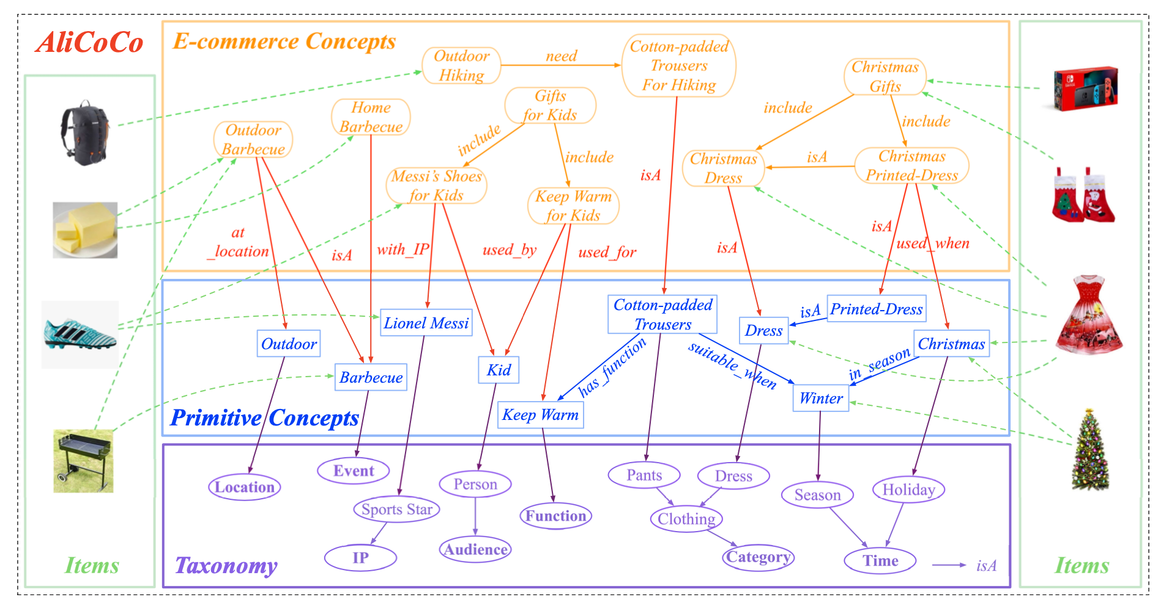
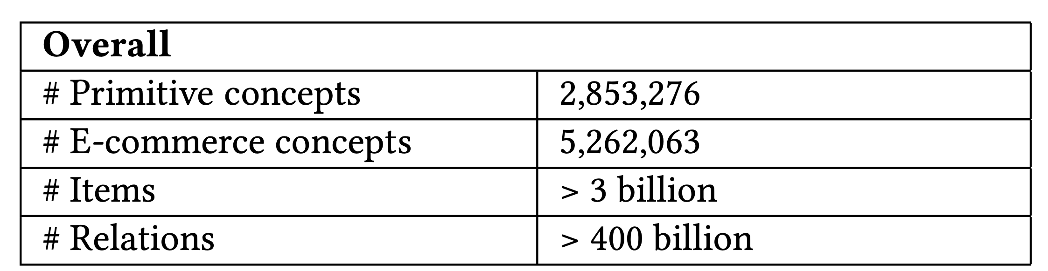
Knowledge Graph in E-commerce
AliCoCo: Alibaba E-commerce Cognitive Concept Net
Goal: to describe and understand user need and items in e-commerce
Luo, X., Liu, L., Yang, Y., Bo, L., Cao, Y., Wu, J., ... & Zhu, K. Q. (2020, June). AliCoCo: Alibaba e-commerce cognitive concept net. In Proceedings of the 2020 ACM SIGMOD international conference on management of data (pp. 313-327).

Slide 10
Knowledge Graph in E-commerce :
AliCoCo overview:
E-commerce concepts: phrases representing user needs
E.g. outdoor barbecue
Primitive concepts: a fundamental language to describe each concept
<Event: Barbecue> | <Location: Outdoor> | <Weather: Sunny> | ...
Taxonomy
Categorize all primitive concepts into classes.
Items
billions of items on Alibaba are related with
both primitive concepts and e-commerce
concepts.
Primitive concepts: properties
E-commerce concepts: scenario

Slide 11
Outline
Introduction
Knowledge Graph in E-commerce
Knowledge Graph Construction
Knowledge Graph Application
Conclusion

Slide 12
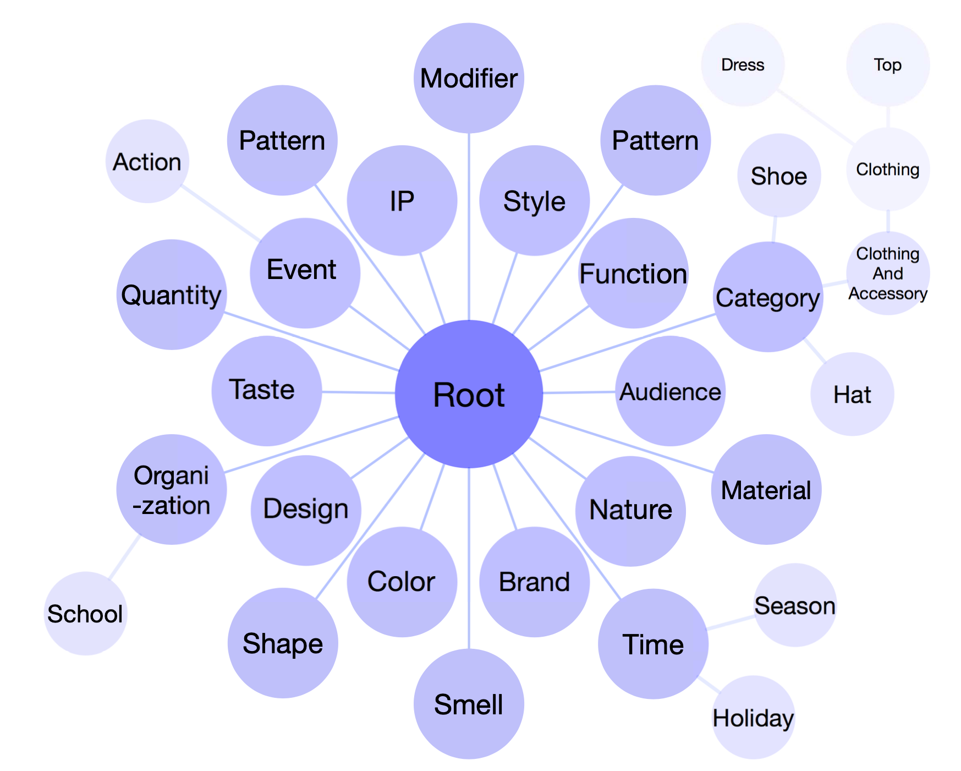
Knowledge Graph Construction:
Taxonomy
A manually defined hierarchy of pre-defined classes to index million of (primitive) concepts.
20 classes defined in the first hierarchy.
“Category”, “Brand”, “Color”, “Design”, “Function”, “Material”, “Pattern”, “Shape” “Smell”, “Taste” and “Style”, etc.
“Category” is the largest one with 800 leaf nodes.

Slide 13
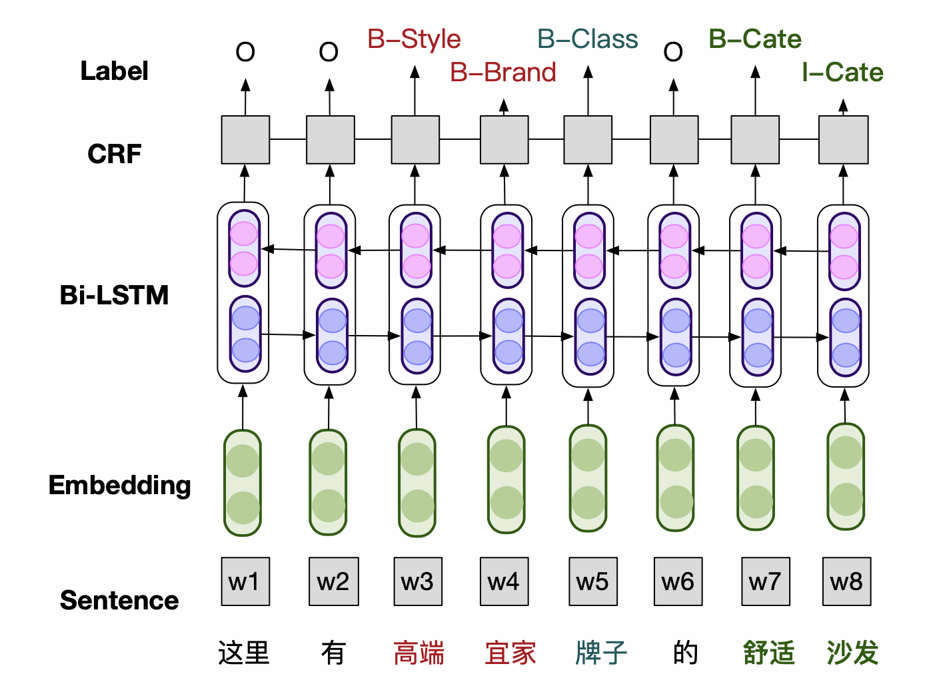
Knowledge Graph Construction:
Primitive Concepts
Aim to describe every item and user need in e-commerce with a class taxonomy.
Vocabulary mining
sequence labeling: BiLSTM-CRF
mine new concepts from large-scale e-commerce corpus:
queries, product titles, user-written reviews, etc.
Hypernym discovery
classify each primitive concept into fine-grained classes.
Pattern based:
“Y such as X ”
“xx裤” isA “裤”
Projection learning:
F(hyponym p, hypernym h) = prob. of isA relationship
Active learning: Uncertainty and high Confidence Sampling strategy (UCS)

Slide 14



Knowledge Graph Construction:
Primary Concepts
Hypernym discovery
Active learning: Uncertainty and high Confidence Sampling strategy (UCS)
Select samples which can improve model effectively to label. (usually difficult samples)
Unlabeled
Dataset D
1. sampling
Labeled Dataset $D_{0}$
2. labeling
Domain expert
3. train
Uncertainty Sampling (US)
pred_score(sample x)≈ 0.5
high Confidence Sampling (CS)
Samples with high confidence
difficult negative samples with relations such as same_as or similar.
5. predict
Model M
4.eval
test set $T$

Slide 15
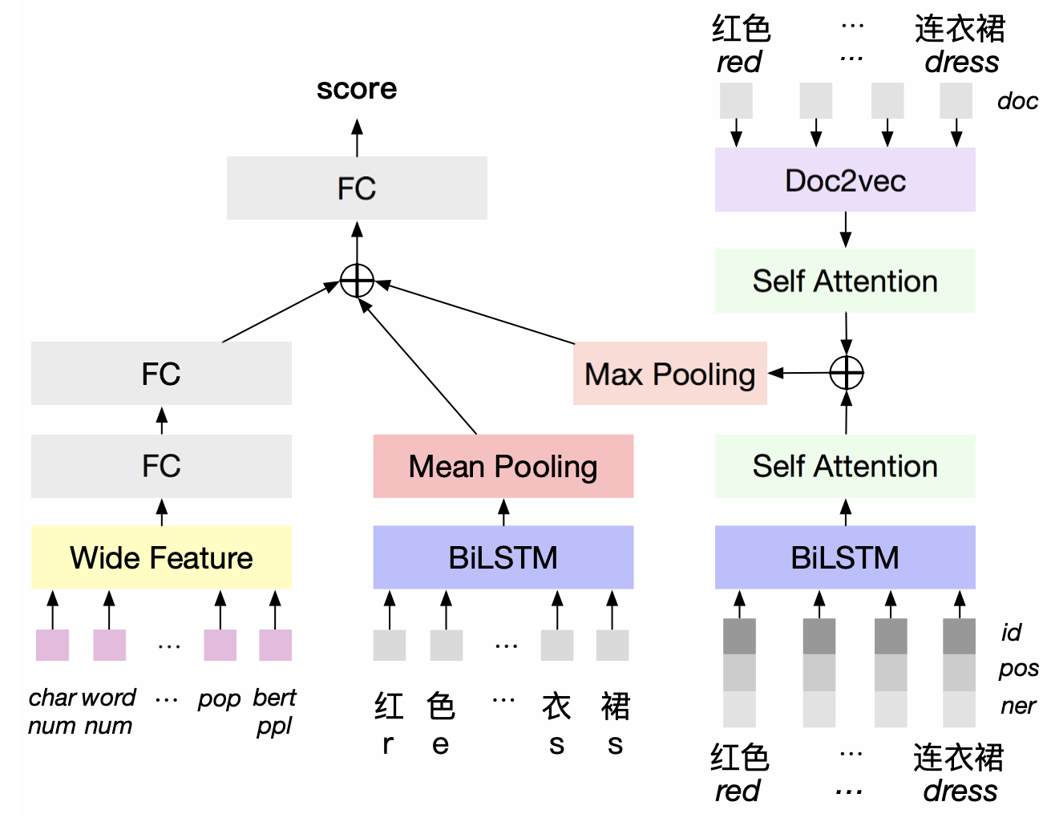
Knowledge Graph Construction:
E-commerce Concepts
Candidate Generation
mining raw concepts from texts.
generating new candidates using existing primitive concepts.
“Location: Indoor”+“Event: Barbecue” → “indoor barbecue”
Classification
judge whether a candidate concept satisfies the criteria of being a qualified e-commerce concept
E.g. “sexy dress for children” ❌
Challenges:
Lack of commonsense knowledge
Lack of surrounding contexts
Knowledge enhanced deep classification model

Slide 16
Knowledge Graph Construction:
E-commerce Concepts
Knowledge enhanced deep classification model
Wide & Deep structure
Deep side:
A char level BiLSTM: encode the candidate concept
knowledge- enhanced module:
Pretrained word embeddings
POS tag embedding
NER label embedding
Doc2vec: encode extracted Wikipedia
article for each word.
Wide side:
Pre-calculated features:
# characters of candidate concept
# words of candidate concept
the perplexity of candidate concept
the popularity of each word appearing in e-commerce scenario
…

Slide 17
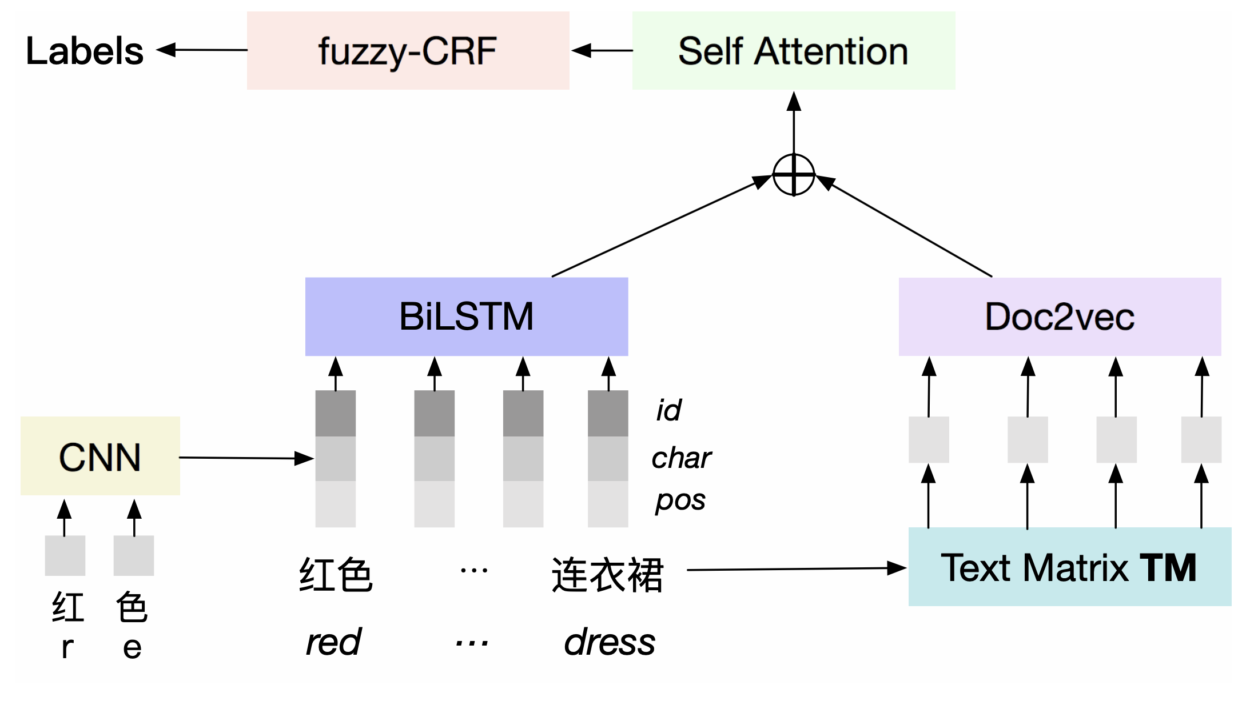
Knowledge Graph Construction:
E-commerce Concepts
Understanding:
e-commerce concept tagging: link e-commerce concepts to the layer of primitive concepts
Outdoor barbecue → <Event: Barbecue> | <Location: Outdoor>
Challenge: short concept phrases (2-3 words on average) → lack of contextual information
→ short text Named Entity Recognition (NER) problem.
text-augmented deep NER model with fuzzy CRF.

Slide 18
Knowledge Graph Construction:
E-commerce Concepts
Understanding: text-augmented deep NER model with fuzzy CRF
BiLSTM
Word-level feature
Char-level feature
POS tagging feature
Textual embedding matrix TM:
mapping each word back to large-scale text corpus to extract surrounding contexts.
lookup each word in TM to obtain a text-augmented embedding.

Slide 19
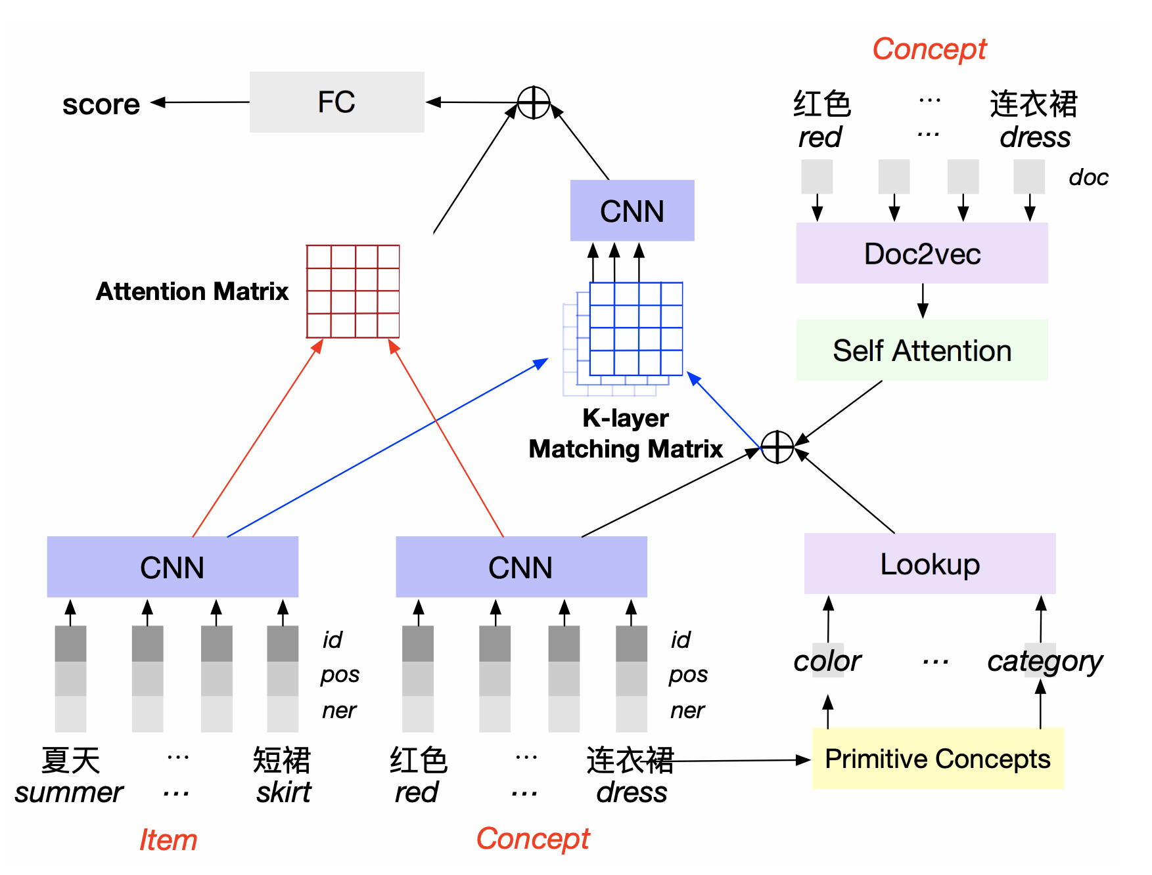
Knowledge Graph Construction:
Item Association:
Associating items with e-commerce concepts.
Input
E-commerce concept
Product title
Knowledge
primitive concept linked with current e-commerce concept.
Wikipedia article of concept.

Slide 20
Outline
Introduction
Knowledge Graph in Industry
Knowledge Graph Construction
Knowledge Graph Application
Conclusion

Slide 21
Knowledge Graph Application
User Intent Understanding
Scenario understanding
Query: “headache”, “stomachache”
<aspirin, is_used_for, headache>
<amoxicillin, is_used_for, stomachache>
Essence understanding
Query: “keaiduo strawberry (可爱多草莓)”, “Lay’s Cucumber (乐事黄瓜)”
“keaiduo strawberry” is a kind of ice-cream instead of strawberry
“Lay’s Cucumber” is a kind of potato chips instead of cucumber
Synonym understanding
Query: “top”
<Jackect, isA, top> → top ~ xx Jacket.
Product Understanding
Lexical Domination Problem:
Pork ~ Pork dumplings
Raw Meat → Pork
Frozen Food → Pork dumplings
Pomelo ~ Pomelo tea
Fruit → Pomelo
Drink → Tea → Pomelo tea

Slide 22
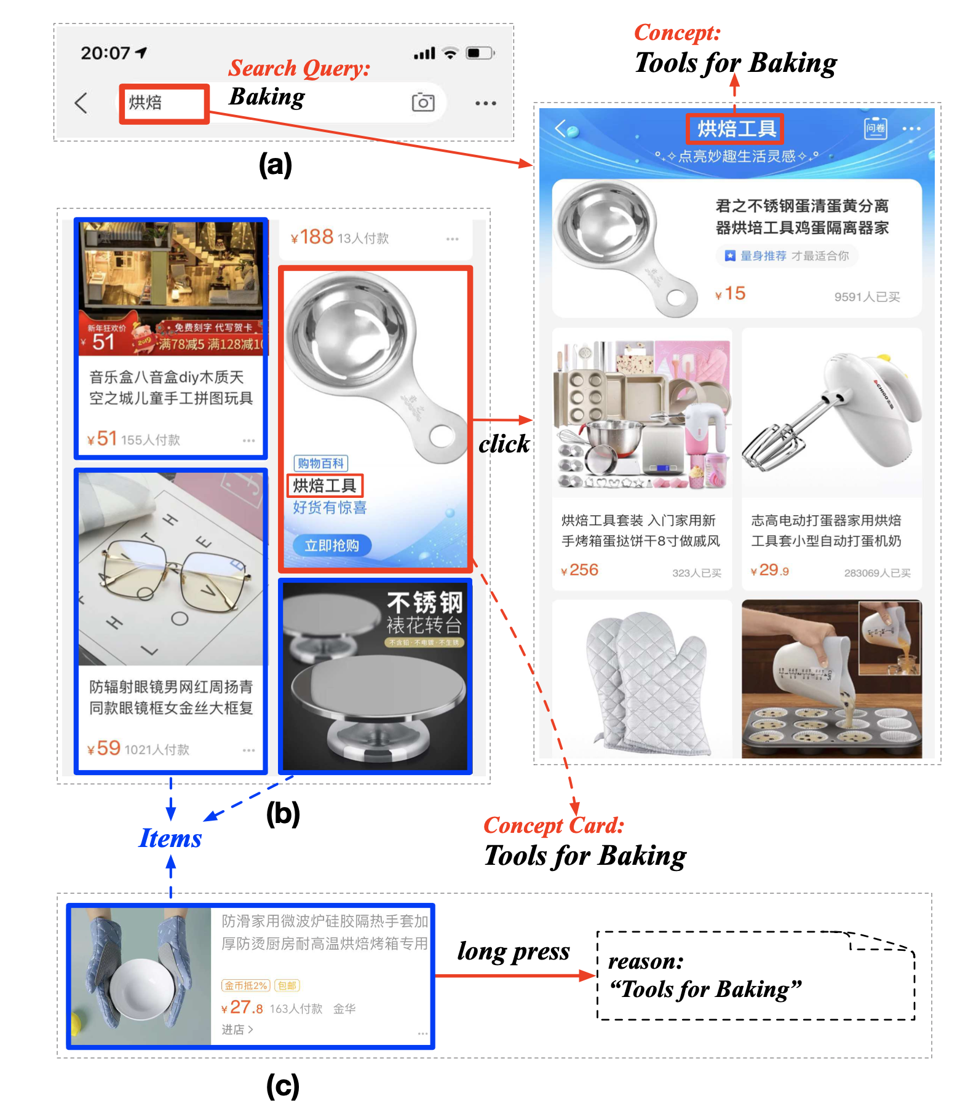
Knowledge Graph Application:
E-commece search
Query: Baking
→ Tools for Baking
Recommendation
Cognitive recommendation
e-commerce concepts:
directly recommending together with its associated items.
Recommendation reason:
“Tools for Baking”

Slide 23
Outline
Introduction
Knowledge Graph in E-commerce
Knowledge Graph Construction
Knowledge Graph Fusion
Conclusion

Slide 24
Conclusion
Takeaways:
Knowledge Graph is a collection of knowledge to help model understand the world better.
Knowledge Graph is widely applied in e-commerce and other industry scenarios.
Internal (from KG itself) and external knowledge is utilized during Knowledge Graph Construction.
Future work:
The construction of Knowledge Graph still relies on human efforts a lot.
Multi-modal Knowledge Graph construction.

Slide 25
Thanks, any questions? ☺

